Slide 1
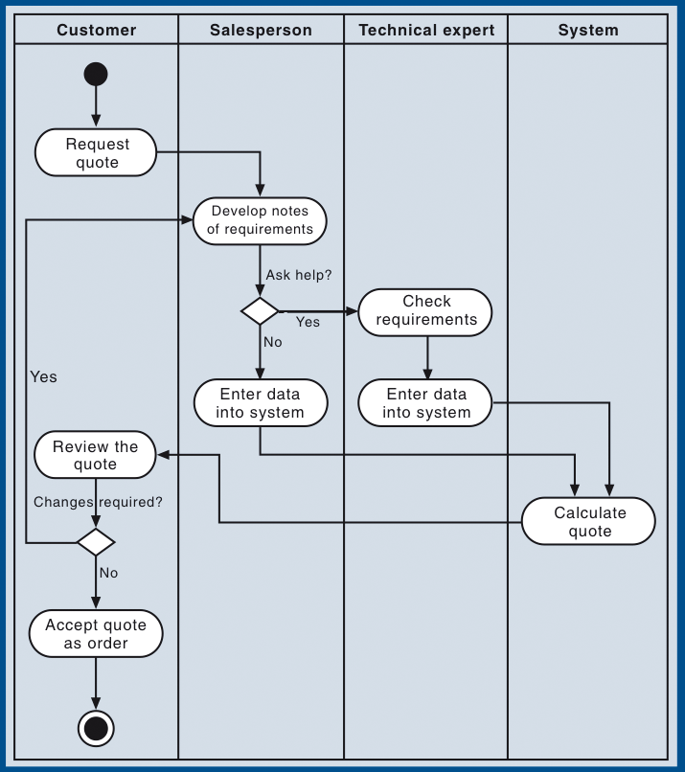
Activity Diagram
that Models a business process required to get the order schedule for production.
From Figure 4-15, page 143, Systems Analysis and Design in a Changing World, 5th Edition, 2009
Please, use this model to all your Activity Diagrams.

